Slide 1
CSCI 3412 Algorithm
Module 7: Quick Sort and Randomized Algorithm

Slide 2
Last Lectures We’ve learned
Asymptotic analysis: various notations
Recurrence Relations!
Calculate the runtime of a recursive algorithm
The Master Method
A useful theorem to answer the runtime of a recursive algorithm easily and quickly.
The Substitution Method
Prove thoughtfully guessed hypothesis of run-time efficiencies using mathematical induction mechanism

Slide 3
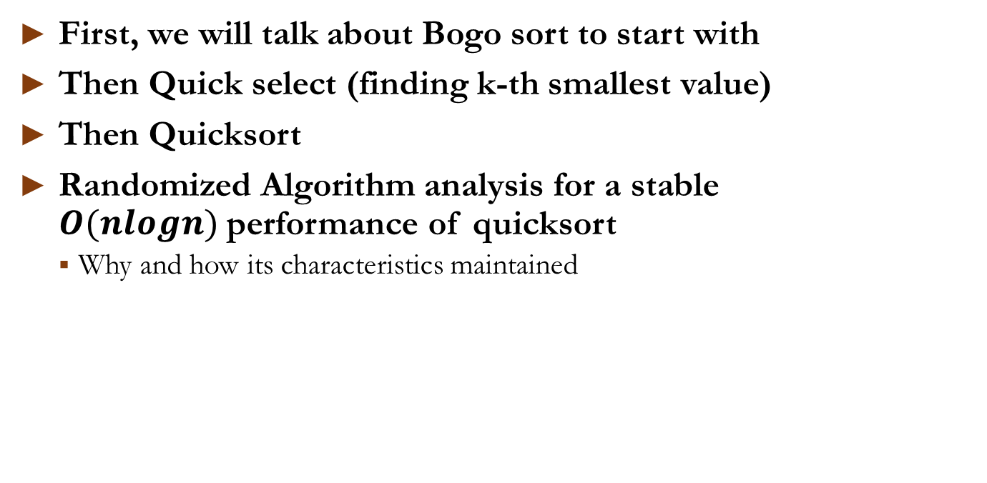
Today (Quick Sort and some more)
First, we will talk about Bogo sort to start with
Then Quick select (finding k-th smallest value)
Then Quicksort
Randomized Algorithm analysis for a stable $O(nlogn)$performance of quicksort
Why and how its characteristics maintained

Slide 4
A starter for Randomness
Bogo sort

Slide 5
Bogo Sort (Bogus + sort)
Bogo sort (also known as monkey sort, permutation sort, stupid sort, slow sort, …) is highly ineffective pure random sorting algorithm
Two versions of handling random data (Recall HW1b ?):
Deterministic version (brute force): enumerating all permutations until sorted in a pre-planned sequence
Pure randomized version: randomly permuting its input. (sorting a deck of cards by throwing the deck into the air, picking the cards up at random, and repeating the process until the deck is sorted)
Brute force version runtime analysis
Total # of iterations of list of size n: n!
Expected running time on a list of length n
= # of iterations * (time per permutation for checking if sorted)
= O(n*n!) #if n = 12, 4,790,016,000 (~ 5B)
import random
def is_sorted(data):
for i in range(len(data) - 1):
if data[i] > data[i + 1]:
return False
return True
def bogosort(data):
while not is_sorted(data):
random.shuffle(data)
return data

Slide 6
Running time of Bogo Sort
We all can tell that it’s the worst algorithm
No intelligence at all in sorting
No adaptation at all in sorting
So, what’s the point? One characteristic of this algorithm.
Pure randomized version,
Worst-case running time: Unbounded ➔ Infinite number !
Best-case running time: 1
The efficiency of the algorithm is depending on the randomness of input data arrangement which may never pick up the sorted list of the input (probability)
Can you think of other sorting algorithm depending on the input data arrangement?

Slide 7
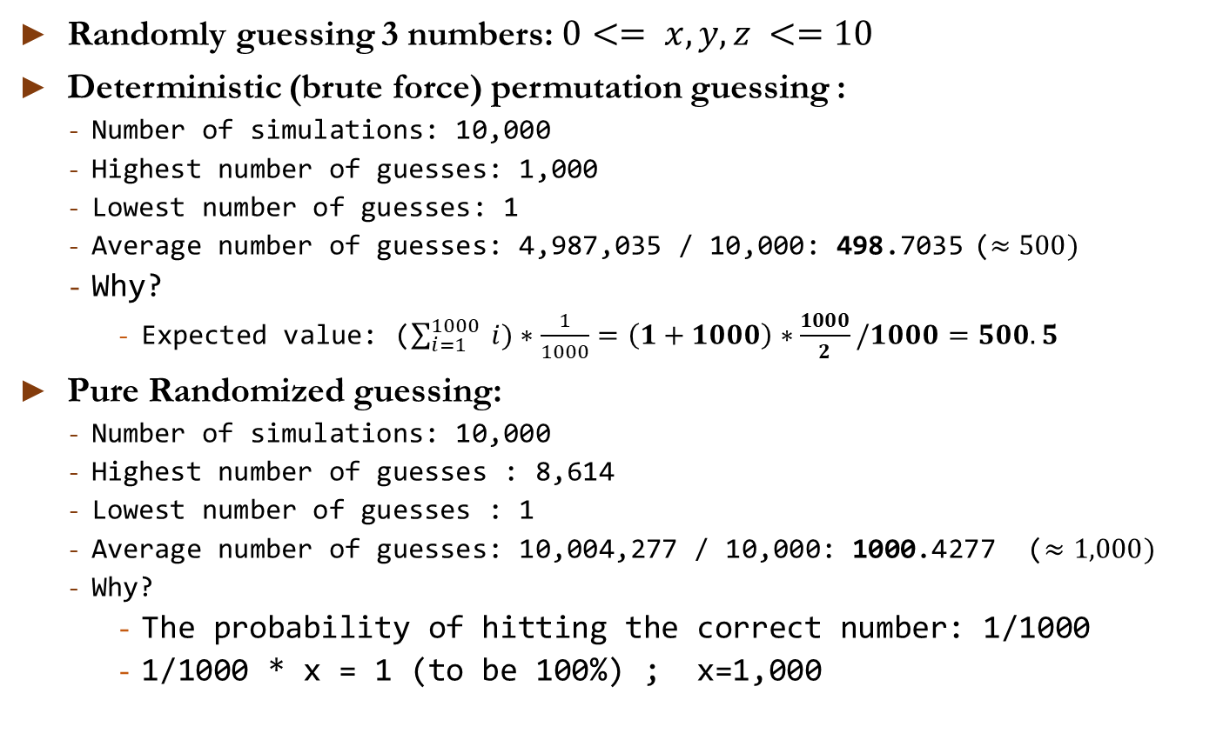
HW1(b) Guessing game statistics
Randomly guessing 3 numbers: $0<= x, y, z <=10$
Deterministic (brute force) permutation guessing :
Number of simulations: 10,000
Highest number of guesses: 1,000
Lowest number of guesses: 1
Average number of guesses: 4,987,035 / 10,000: 498.7035 ($≈500)$
Why?
Expected value: ($\sum_{i=1}^{1000}{ i)∗\frac{1}{1000}=\left(1+1000\right)∗\frac{1000}{2}/1000=500.5}$
Pure Randomized guessing:
Number of simulations: 10,000
Highest number of guesses : 8,614
Lowest number of guesses : 1
Average number of guesses: 10,004,277 / 10,000: 1000.4277 ($≈1,000)$
Why?
The probability of hitting the correct number: 1/1000
1/1000 * x = 1 (to be 100%) ; x=1,000

Slide 8
K^{th} smallest value a.k.a. Quick select, Partition()

Slide 9
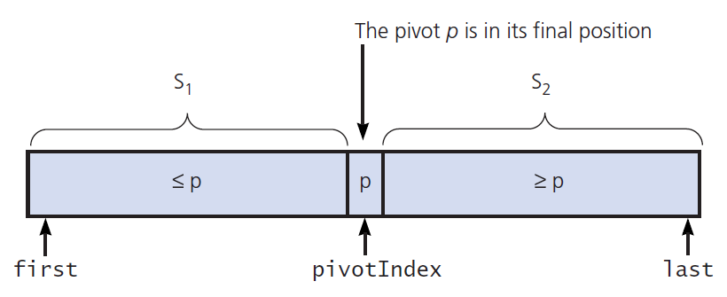
K^{th} smallest value (a.k.a. quick select) Finding k^{th} Smallest Value of an “Unsorted” Array

Slide 10
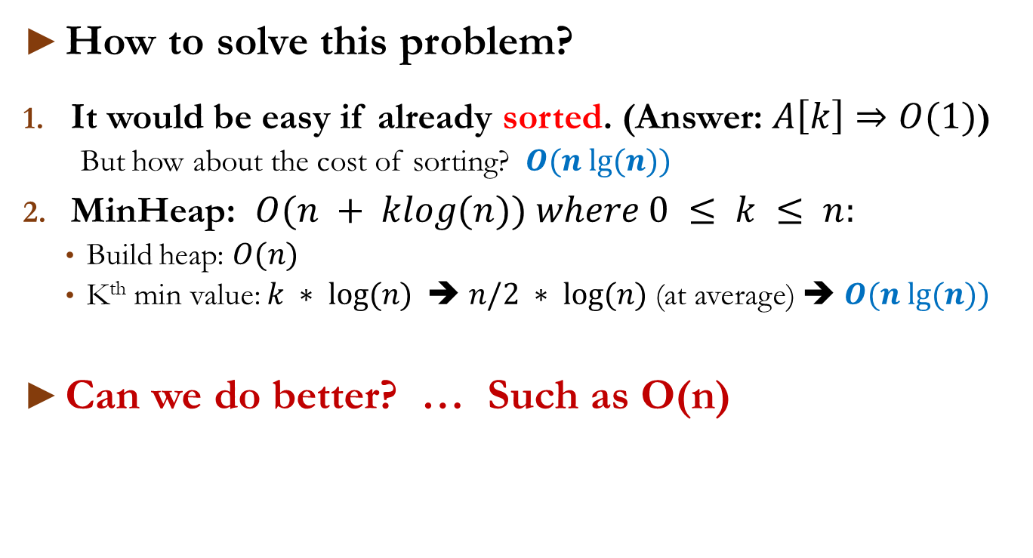
k^{th} Smallest Value of “Unsorted” Array
How to solve this problem?
It would be easy if already sorted. (Answer: $A\left[k\right]⇒O(1)$)
But how about the cost of sorting? $O(n lg⁡(n))$
MinHeap: $O(n + klog(n)) where 0 ≤ k ≤ n:$
Build heap: $O(n)$
K^{th} min value: $k ∗ log⁡(n)$➔ $n/2 ∗ log⁡(n)$(at average) ➔ $O(n lg⁡(n))$
Can we do better? … Such as O(n)

Slide 11
k^{th} Smallest Value of an “Unsorted” Array
Recursive solution proceeds by:
Selecting a pivot value in array
Cleverly arranging/ partitioning values in array about pivot value (like shoving in an elephant into a refrigerator)
Recursively applying strategy to one of partitions until finding k^{th} smallest value
Final goal : pivotIndex == k
**NOTE : We don’t care if the subarrays (S₁, S₂) are sorted or not

Slide 12
Finding 4th Smallest Value of Array
Algorithm:
: next number
: Pivot
: next number (possibly) higher than pivot
If (green num < pivot (6) ) then {swap(yellow, green); move yellow →}; move green →
2 | 9 | 8 | 4 | 1 | 7 | 3 | 5 | 6
Pivot
2 | 9 | 8 | 4 | 1 | 7 | 3 | 5 | 6
2 | 9 | 8 | 4 | 1 | 7 | 3 | 5 | 6
2 | 4 | 8 | 9 | 1 | 7 | 3 | 5 | 6
2 | 4 | 1 | 9 | 8 | 7 | 3 | 5 | 6
Smaller than pivot
Larger than pivot
Untested yet
2 | 4 | 1 | 3 | 8 | 7 | 9 | 5 | 6
2 | 4 | 1 | 3 | 5 | 7 | 9 | 8 | 6
2 | 4 | 1 | 3 | 5 | 6 | 9 | 8 | 7

Slide 13
Finding 4th Smallest Value of Array
2 | 4 | 1 | 3 | 5 | 6 | 9 | 8 | 7
4<6
2 | 4 | 1 | 3 | 5 | 6 | 9 | 8 | 7
New pivot
(4 < 5)
2 | 4 | 1 | 3 | 5 | 6 | 9 | 8 | 7
New Pivot
2 | 1 | 3 | 4 | 5 | 6 | 9 | 8 | 7
New Pivot
(4 > 3)
2 | 1 | 3 | 4 | 5 | 6 | 9 | 8 | 7
4th
Got the answer!!

Slide 14
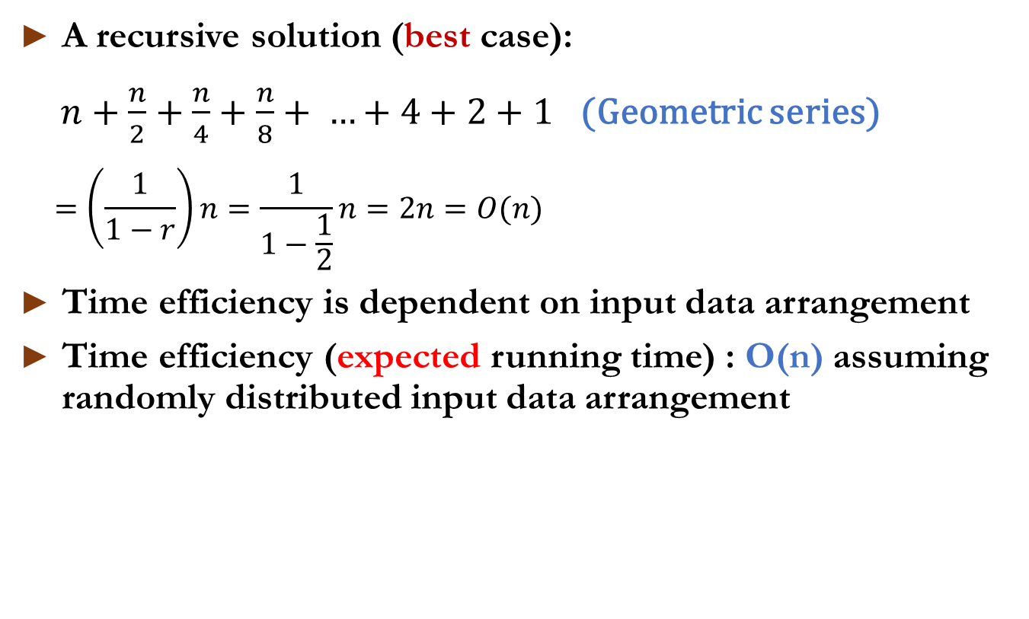
Time Efficiency
A recursive solution (best case):
$n+\frac{n}{2}+\frac{n}{4}+\frac{n}{8}+ …+4+2+1$ (Geometric series)
$$=\left(\frac{1}{1−r}\right)n=\frac{1}{1−\frac{1}{2}}n=2n=O(n)$$
Time efficiency is dependent on input data arrangement
Time efficiency (expected running time) : O(n) assuming randomly distributed input data arrangement

Slide 15
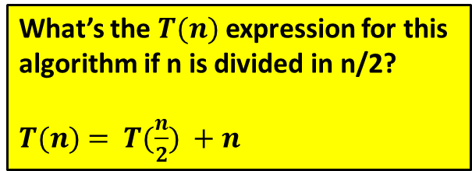
Finding k^{th} Smallest Value of Array
#x:pivot,i:yellow,j:green
def partition(arr, l, r): x = arr[r] # rightmost i = l #next higher for j in range(l, r): if (arr[j] <= x): swap(arr, i, j) i += 1 swap(arr, i, r) return i
def kthSmallest(arr, l, r, k):
if (k > 0 and k <= r - l + 1):
pos = partition(arr, l, r)
# If position is same as k
if (pos - l == k - 1):
return arr[pos]
# recur for left subarray
if (pos - l > k - 1):
return kthSmallest(arr, l, pos - 1, k)
#recur for right subarray
return kthSmallest(arr, pos + 1, r, k - pos + l - 1)
What’s the $T(n)$expression for this algorithm if n is divided in n/2?
$T(n)$ $= T(\frac{n}{2}) +n$

Slide 16
Quicksort
An extension of k^{th} smallest algorithm
A randomized algorithm

Slide 17
Quick Sort – a randomized algorithm
Algorithm description:
Quicksort, like merge sort, applies divide-and-conquer paradigm:
Divide: Partition (rearrange) the array A[first .. last], p = A[q]
Two subarrays A[first .. q -1](S₁), p=A[q], A[q +1 .. last](S₂)
Each element of S₁ <= p, and p <= S₂
Returning q as the result of this partitioning.
Conquer & combine: Sort the two subarrays A[first .. q – 1] and A[q+1 .. last] by recursive calls. Because the final subarrays are already sorted, no further work is needed
q

Slide 18
Quick Sort – a randomized algorithm
def quicksort (arr,low,high):
if low < high:
pi = partition(arr,low,high)
quickSort(arr, low, pi-1)
quickSort(arr, pi+1, high)
def partition (arr,low,high):
i = ( low-1 ) # index of smaller element
pivot = arr[high] # pivot
for j in range(low , high):
if arr[j] <= pivot:
i = i+1
arr[i],arr[j] = arr[j],arr[i]
arr[i+1],arr[high] = arr[high],arr[i+1]
return ( i+1 )
Q1) How is it different from merge sort ?
The same partition() of Quick Select Algorithm
Q2) How is it different from K^{th} smallest?

Slide 19
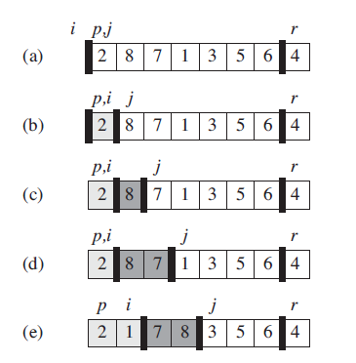
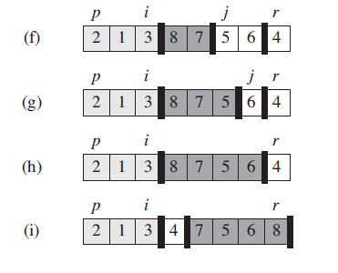
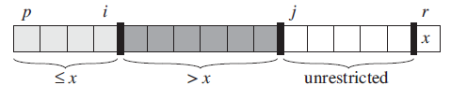
Quick Sort – Partition Review
The operation of PARTITION:
Array entry A[r] becomes the pivot element x.
Lightly shaded array elements with values no greater than x.
Heavily shaded elements are with values greater than x.
The unshaded elements have not yet been processes, and
the final white element is the pivot x.
Correctness check:
Check the loop invariant:
** Mathematical induction on the loop invariant
** (Page 173)

Slide 20
Correctness of Quicksort
Using simple mathematical induction
Induction Hypothesis:
Assume that Quicksort correctly sorts any array of 𝑘 elements for all 𝑘≤𝑛. This is the induction hypothesis.
Inductive step
Less than x and sorted by hypothesis | x | Larger than x and sorted by hypothesis

Slide 21
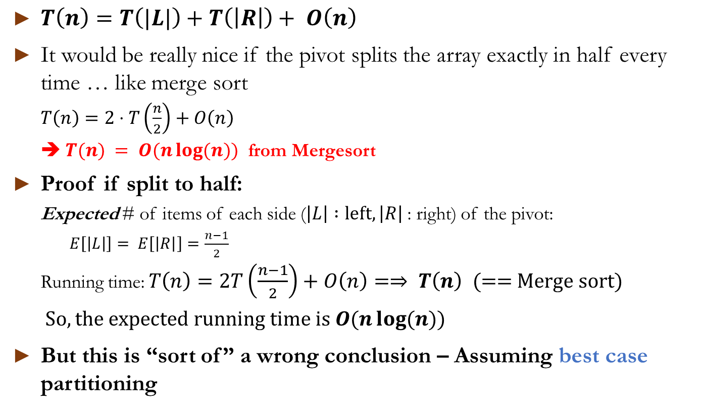
Running time of Quick Sort
$T\left(n\right)=T\left(|L|\right)+T\left(\left|R\right|\right)+ O\left(n\right)$
It would be really nice if the pivot splits the array exactly in half every time … like merge sort
$T\left(n\right)=2⋅T\left(\frac{n}{2}\right)+O\left(n\right)$
➔ $T(n) = O(n\log{(n)})$ from Mergesort
Proof if split to half:
Expected # of items of each side ($\left|L\right| :left,\left|R\right|$ : right) of the pivot:
$E\left[\left|L\right|\right]= E\left[\left|R\right|\right]=\frac{n−1}{2}$
Running time: $T\left(n\right)=2T\left(\frac{n−1}{2}\right)+O\left(n\right)=⇒ T\left(n\right)$ (== Merge sort)
$So, the expected running time is O(n\log{(n)})$
But this is “sort of” a wrong conclusion – Assuming best case partitioning

Slide 22
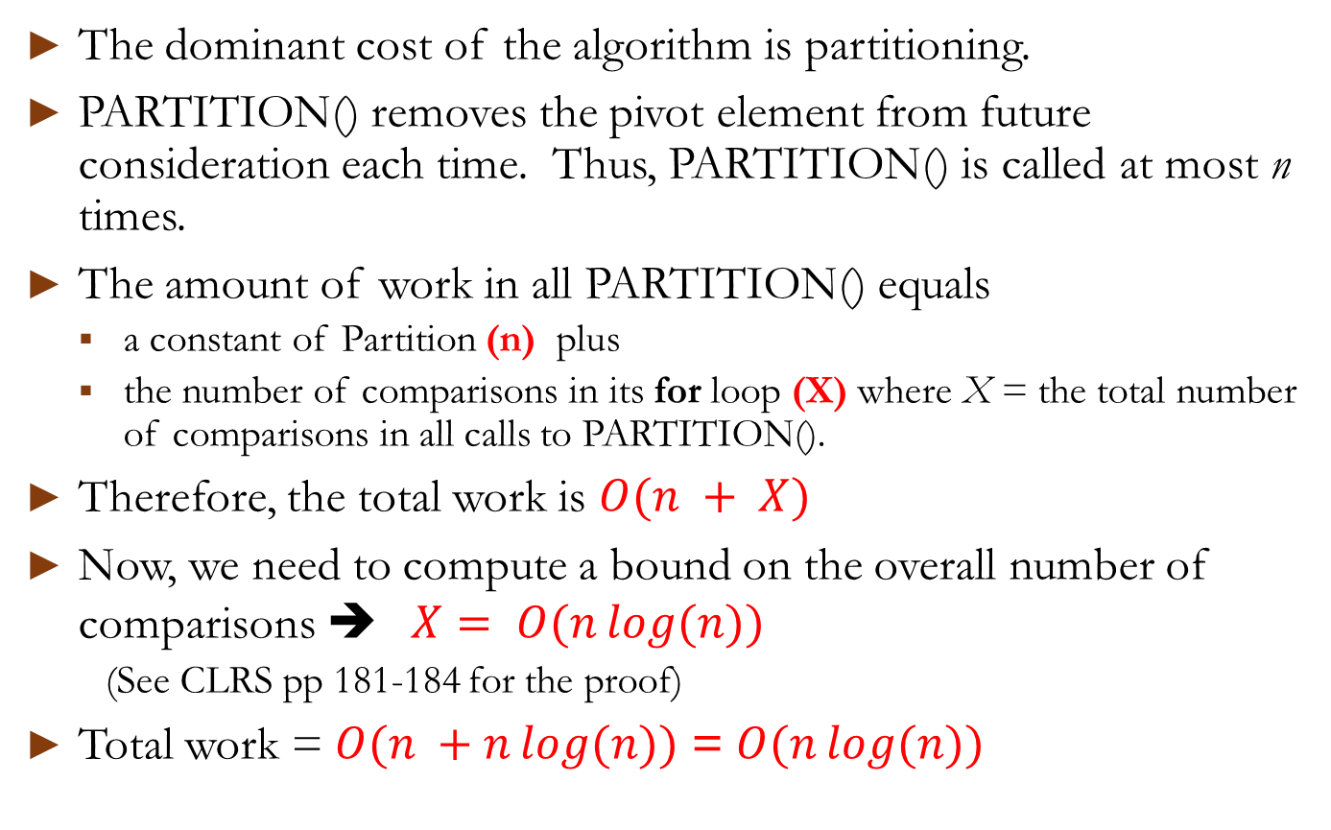
Expected running time of best case
The dominant cost of the algorithm is partitioning.
PARTITION() removes the pivot element from future consideration each time. Thus, PARTITION() is called at most n times.
The amount of work in all PARTITION() equals
a constant of Partition (n) plus
the number of comparisons in its for loop (X) where X = the total number of comparisons in all calls to PARTITION().
Therefore, the total work is $O(n + X)$
Now, we need to compute a bound on the overall number of comparisons ➔ $X= O(n\log{(n)})$
(See CLRS pp 181-184 for the proof)
Total work = $O(n +n\log{(n)})$ = $O(n\log{(n)})$

Slide 23
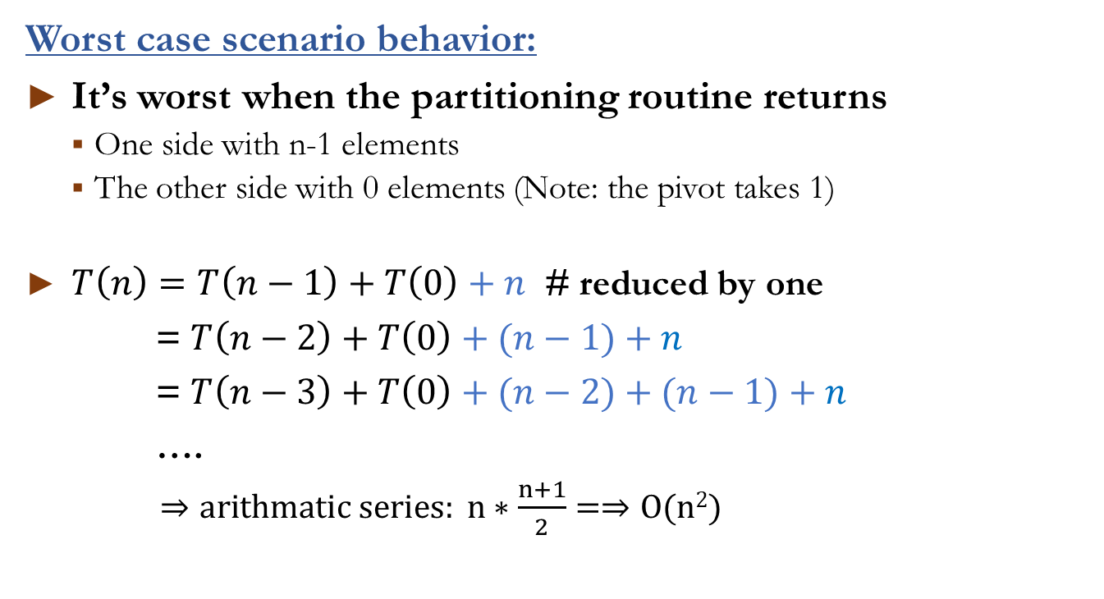
Expected Running time of worst case
Worst case scenario behavior:
It’s worst when the partitioning routine returns
One side with n-1 elements
The other side with 0 elements (Note: the pivot takes 1)
$T\left(n\right)=T\left(n−1\right)+T\left(0\right)+n$ # reduced by one
= $T\left(n−2\right)+T\left(0\right)+(n−1)+n$
= $T\left(n−3\right)+T\left(0\right)+(n−2)+(n−1)+n$
….
$⇒arithmatic series: n∗\frac{n+1}{2}=⇒O(n2)$

Slide 24
Randomized Algorithm (Average case analysis)

Slide 25
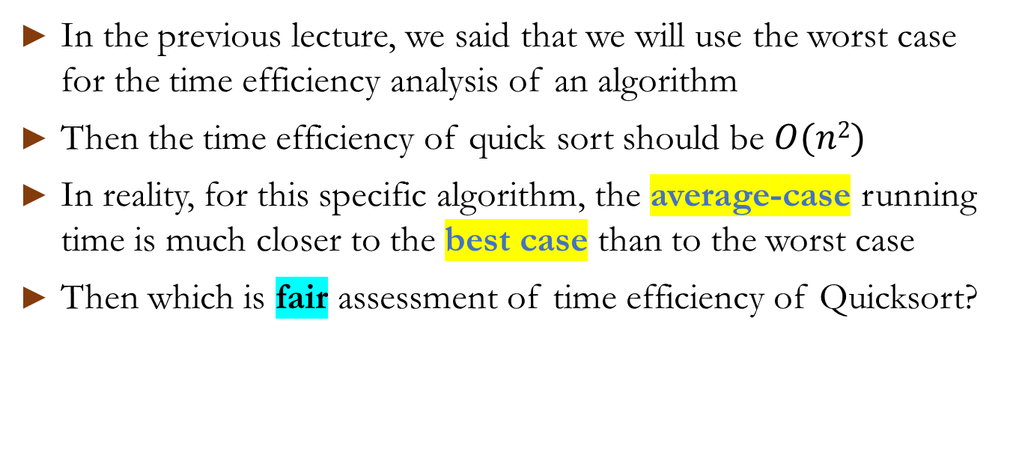
Average case Running time of Quick Sort
In the previous lecture, we said that we will use the worst case for the time efficiency analysis of an algorithm
Then the time efficiency of quick sort should be $O(n2)$
In reality, for this specific algorithm, the average-case running time is much closer to the best case than to the worst case
Then which is fair assessment of time efficiency of Quicksort?

Slide 26
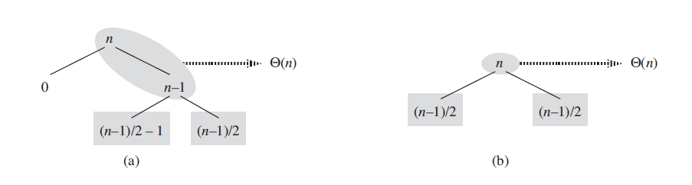
Average case Running time of Quick Sort (Intuitively speaking)
At average, suppose you alternate good splits and bad splits.
(a) The partitioning at the root costs n and produces a “bad” split: two subarrays of sizes 0 and n-1. Then, partitioning of the subarray of size n - 1 costs n - 1 and produces a “good” split: subarrays of size, (n-1)/2 – 1 & (n-1)/2
(b) A single level of a recursion tree that is very well balanced. In both parts, the partitioning cost for the subproblems is O(n). Yet the subproblems remaining to be solved in (a), shown with square shading, are no larger than the corresponding subproblems in (b).
Birthday Paradox (probability theory):
In a set of randomly chosen people, some pair of them will have the same birthday (365 days/year):
- 50% probability with 23 people
- 99.9% with just 69 people
- CLRS: Section 5.4.1

Slide 27
Birthday Paradox Probability
https://en.wikipedia.org/wiki/Birthday_problem
2 | 0.997260274 | 0.27%
3 | 0.991795834 | 0.82%
4 | 0.983644088 | 1.64%
10 | 0.883051822 | 11.69%
18 | 0.653088582 | 34.69%
22 | 0.524304692 | 47.57%
23 | 0.492702766 | 50.73%
24 | 0.461655742 | 53.83%
27 | 0.373140718 | 62.69%
28 | 0.345538528 | 65.45%
34 | 0.204683135 | 79.53%
35 | 0.185616761 | 81.44%
36 | 0.167817894 | 83.22%
37 | 0.151265992 | 84.87%
38 | 0.135932179 | 86.41%
44 | 0.067114631 | 93.29%
45 | 0.059024101 | 94.10%
46 | 0.051747157 | 94.83%
47 | 0.045225597 | 95.48%
48 | 0.039402027 | 96.06%
49 | 0.034220391 | 96.58%
50 | 0.02962642 | 97.04%
51 | 0.025568007 | 97.44%
52 | 0.021995491 | 97.80%
65 | 0.002316893 | 99.77%
66 | 0.001904295 | 99.81%
69 | 0.001036334 | 99.90%
70 | 0.000840424 | 99.92%
Probability of having the same Birthday:
Pr(Bk} = 1 – (1*(n-1/n)(n-2/n) .. (n-(k-1)/n))
For 23 people:
1 –(1*(364/365)*(363/365) .. (342/365))
= ~0.5 (50%)
Why birthday paradox?
A counterintuitive probability problem: it's referred to as a "paradox" because the probability of a matching birthday tends to be much higher than what people commonly expect. Just as the Birthday Paradox shows, Quick Sort's average efficiency shows that, on average, it performs well with large size inputs, even though some inputs can lead to poor performance.

Slide 28
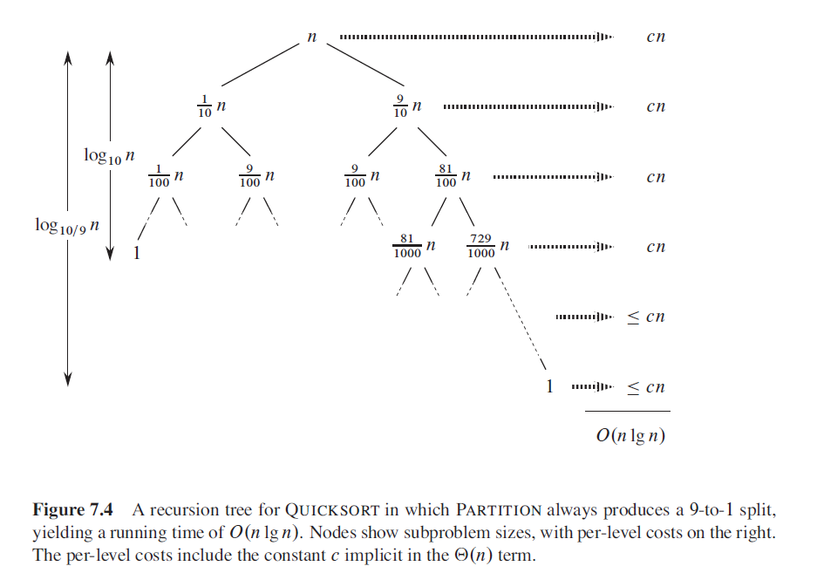
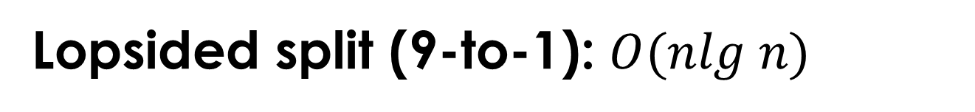

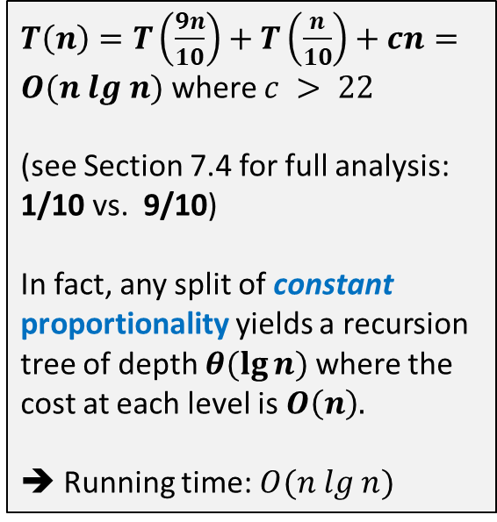
Lopsided split (9-to-1): $O(nlg n)$
$T\left(n\right)=T\left(\frac{9n}{10}\right)+T\left(\frac{n}{10}\right)+cn=O(n lg n)$ where $c > 22$
(see Section 7.4 for full analysis: 1/10 vs. 9/10)
In fact, any split of constant
proportionality yields a recursion tree of depth $θ(\lg{n) }$where the cost at each level is $O\left(n\right).$
➔ Running time:$O(n lg n)$
$${C= log}_{10/9}{10 ≈22}$$

Slide 29
Randomized Algorithm
As we’ve seen in quicksort and bogosort algorithms, A randomized algorithm employs a degree of randomness as part of its logic and the randomness of the data is crucial in showing the algorithm efficiency.
An algorithm is categorized randomized if its behavior(efficiency) is determined by not only by its value but also by the degree of randomness of the values (data arrangement).
The analysis of the running time of a randomized algorithm is the expectation of running time over the distribution of values returned by the random number generator.
The algorithm typically uses uniformly random bits as an auxiliary input to guide its behavior, in the hope of achieving good performance in the "average case" over all possible choices of random bits. (random partition)

Slide 30


Randomized quicksort algorithm
We often assumes that all input permutations are equally likely (best case)
This is not always true.
To correct this, we add randomization to quicksort.
Two ways we can think of:
We could randomly permute the input array. (Game cards shuffling)
Use random sampling. Don’t always use A[r ] as the pivot. Instead, randomly pick an element from the subarray that is being sorted.

Slide 31
Final thoughts
Comparison between merge sort and quick sort

Slide 32
Some Considerations
Note that the Python code from the earlier slide rearranges the subarray in-place as suggested in CLRS book (page 171) without separate L and R lists as shown in many pseudocodes
Here are some Hungarian Folk Dancers showing you how it’s done: https://www.youtube.com/watch?v=ywWBy6J5gz8
NOTE: done by opposite order in traversal and selecting pivot from class examples.

Slide 33
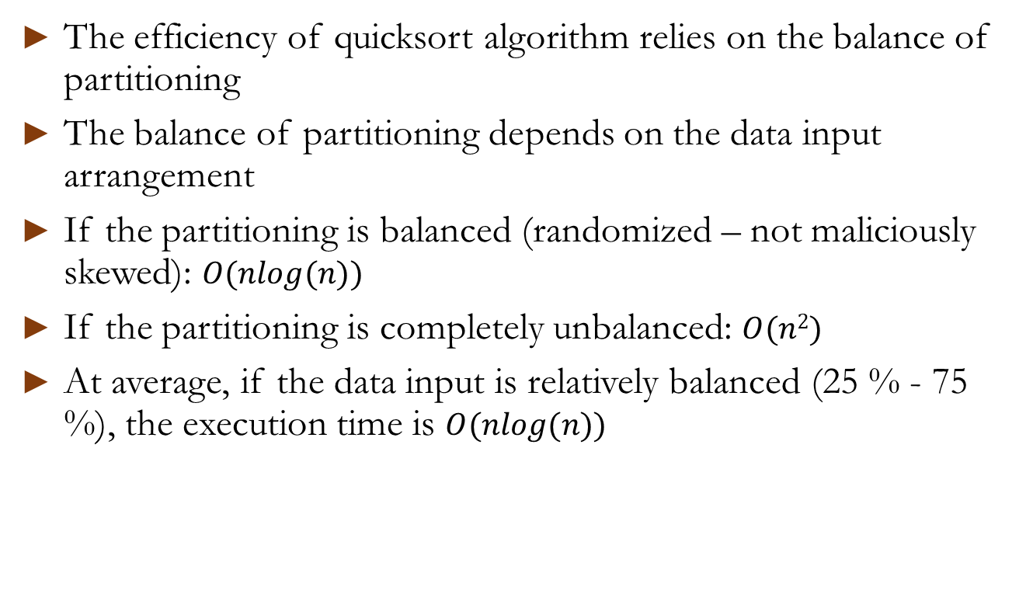
Quicksort Time Efficiency Summary
The efficiency of quicksort algorithm relies on the balance of partitioning
The balance of partitioning depends on the data input arrangement
If the partitioning is balanced (randomized – not maliciously skewed): $O(nlog(n))$
If the partitioning is completely unbalanced: $O(n2)$
At average, if the data input is relatively balanced (25 % - 75 %), the execution time is $O(nlog(n))$

Slide 34
Merge Sort vs Quick Sort
 | Quick Sort (Randomized) | Merge Sort (Divide & Conquer)
Recursion* | Divide: Partition: O(n) Quicksort(left Partition) Quicksort(right Partition) Combine: trivial O(1) | Divide: trivial (m = (1 + r) / 2) O(1) Mergesort(Left Half) Mergesort(Right Half) Combine: Merging: O(n)
Partition* | Possibly any (random) ratio | Exactly half (Half and Half)
Additional Storage | Less (in-place) | Need to make copies of left and right halves
Stability* | No | Yes
Reference locality | Good | Not so good
For large data | Less efficient | More efficient
For smaller data | More efficient | Works the same for all size
Worst case | O(n²) | O(nlog(n))
Best/Average case | O(nlog(n)) | O(nlog(n))
Used by | Java for primitive types C qsort Unix | Java for objects Perl

